Slide 1
Neural networks and Physical Systems with Emergent Collective Computational Abilities, J. J. Hopfield (1982)
Anthony Porturas and Jessie George

Slide 2
Collective Properties from Simple Components
Example: In a magnetic system, magnetic dipoles interact to give collective properties like stable magnetic orientations and domains.
In a neural network, what are the collective properties?
Focus on collective properties that are robust against change in model details.
Example: Sound waves depend on collisions, but any reasonable interatomic force law will yield appropriate collisions.

Slide 3
Content-Addressable Memory
RAM: memory address → data word stored at that address
CAM: data word → list of one or more storage addresses where the word was found (and in some architectures, it also returns the contents of that storage address, or other associated pieces of data).
CAM retrieves the entire memory based on sufficient partial information.
Example: “Seuss Cat” → “Dr. Seuss - The Cat in the Hat” (+ storage address)
k bits of neurons → N bits of neurons (where k<N)

Slide 4
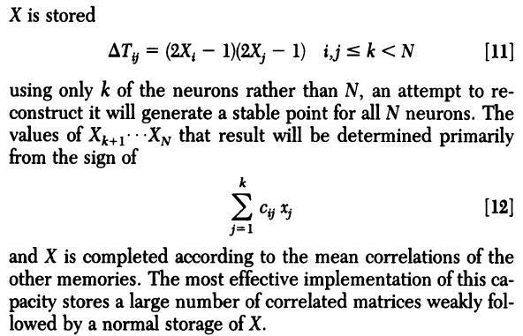
c_{ij} is the correlation matrix = average T_{ij}

Slide 5
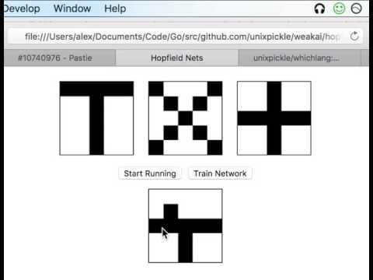
Video example of Hopfield Network

Slide 6
Consider a system with coordinates X₁ … X_{N}
Let the system have locally stable limit points X_{a} , X_{b} …
Then, if the system is started sufficiently near any X_{a}, as at X = X_{a} + Δ,
it will proceed in time until X ≅ X_{a}.
We can regard the information stored in the system as the vectors X_{a} , X_{b} …
The starting point X = X_{a} + Δ represents a partial knowledge of the item X_{a},
and the system then generates the total information X_{a}.
Any physical system whose dynamics in phase space is dominated by a substantial number of locally stable states to which it is attracted can therefore be regarded as a general content-addressable memory.

Slide 7
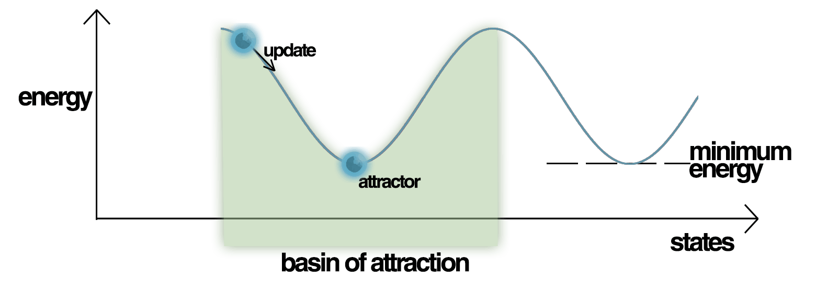
Energy Landscape of Hopfield Network (showing attractors)

Slide 8
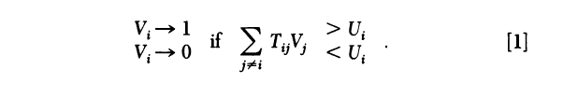
The Model
The state of the model is defined by an N bit binary word. Example: 1110011
Each digit is V_{i} = 0 or 1 (0 if i is not firing, 1 if i is firing at max rate)
i is the post-synaptic neuron, j is the pre-synaptic neuron
T_{ij} is the strength of connection between i and j (a.k.a the effectiveness of synapse).
U_{i} is the fixed threshold for i. (We choose U_{i} =0) Each neuron randomly and asynchronously evaluates if it is above/below threshold with a mean attempt rate W.

Slide 9

Other models (like Perceptron) focuses on forward connection of neurons
While Hopfield Networks can analyze backward coupling

Slide 10

Information Storage Algorithm
T_{ii} = 0
s is the state number, s = 1 … n.
V_{i}^{s} is the state of neuron i.
Plugging in values for a single state:
(2x1 - 1)(2x1 - 1) = 1
(2x0 - 1)(2x0 - 1) = 1
(2x1 - 1)(2x0 - 1) = -1
(2x0 - 1)(2x1 - 1) = -1

Slide 11
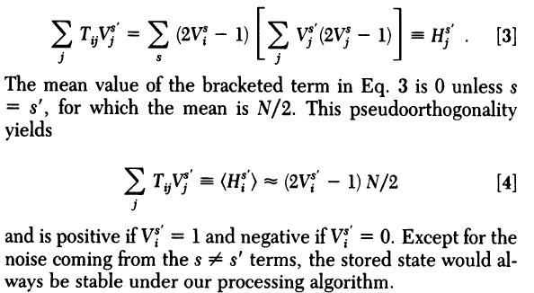
H_{i}^{s’} is the effective field of neuron i when the state of the system is s’

Slide 12
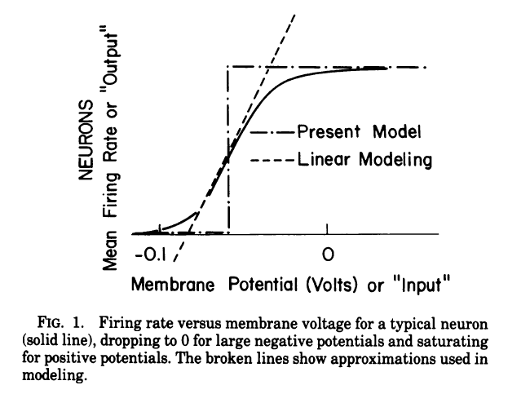
Biological Interpretation of the Model

Slide 13
Biological Interpretation of the Model
The mean firing rate is a smooth function of the membrane potential.
The biological information sent to other neurons often lies in a short-time average of the firing rate. So we can neglect the details of individual action potentials and regard the figure as a smooth input-output step.
Linear associative networks have emphasized the linear central region of the figure.
But a study of emergent collective effects and spontaneous computation must necessarily focus on the nonlinearity of the input-output relationship. Those neurons whose operation is dominantly linear merely provide a pathway of communication between nonlinear neurons. Thus, we consider a network of on or off neurons, granting that some of the interconnections may be by way of neurons operating in the linear regime.

Slide 14
Delays in synaptic transmission (of partially stochastic character) and in the transmission of impulses along axons and dendrites produce a delay between the input of a neuron and the generation of an effective output. All such delays have been modeled by a single parameter, the stochastic mean processing time 1/W.
(Remember we said W is the mean attempt rate, where each neuron i attempts to update itself based on whether it is above or below the threshold.)

Slide 15

Most models can compute T_{ij} like this, where the average is some appropriate calculation over past history:
We will therefore assume that such a T_{ij} has been produced by previous experiments or inheritance. The Hebbian property need not reside in single synapses; small groups of cells which produce such a net effect would suffice.
Hopfield model performs abstract calculations for which the inputs should be appropriately coded. Example: In visual processing, feature extraction should previously have been done. Hopfield model will then ‘remember’ or ‘categorize’ on the basis of given inputs.
(hashmap metaphor)

Slide 16
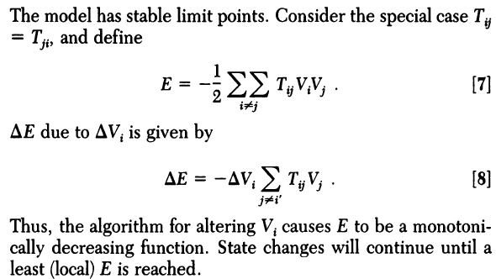
Collective Behaviors of the Model

Slide 17
The experiment
Monte Carlo calculations (i.e. random sampling) were made on a system of N=30 to examine the effect of removing T_{ij} = T_{ji} restriction. Each element of T_{ij} was chosen as a random number between -1 and 1. The dynamics algorithm was initiated from randomly chosen initial starting configurations. Within a time of about 4/W it settled into limiting behaviors, the commonest being a stable state.
(Remember we said W is the mean attempt rate, where each neuron i attempts to update itself based on whether it is above or below the threshold. Here 4/W is the processing time.)

Slide 18
3 Behaviors of the Model
The first behavior: A few stable states collect the flow from most of the initial state space. (When 50 trials were examined for a particular random matrix, all would result in one of two or three end states.)

Slide 19
3 Behaviors of the Model
The second behavior: A simple cycle occasionally occurred.
Example:

Slide 20
3 Behaviors of the Model
The third behavior: The chaotic wandering occurred within a short Hamming distance of one particular state.
The Hamming distance between two binary states A and B is defined as the number of places in which the digits are different.
Example:
State A = 1 1 1 0 0 0 1 1 1
State B = 1 0 1 0 1 1 1 1 1
Hamming distance = 3

Slide 21

Entropy
p_{i} is the probability of occurrence of a wandering state
M is the entropic measure of available states
M = 25 for N = 30

Slide 22
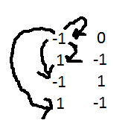
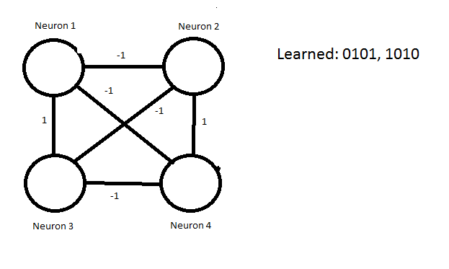
Train a network of N = 4 : 0101 and consequently, 1010
0’s are -1’s (neuron is off)
0101 -> -1,1,-1,1
(weights for row one)
Weights between neurons:
 | Neuron 1 | Neuron 2 | Neuron 3 | Neuron 4
Neuron 1 | 0 | -1 | 1 | -1
Neuron 2 | -1 | 0 | -1 | 1
Neuron 3 | 1 | -1 | 0 | -1
Neuron 4 | -1 | 1 | -1 | 0

Slide 23
General Idea:
Input: state of neurons
Randomly select a neuron to flip from off to on or on to off
If total energy is lower than before, then keep the change
Energy is measured by adding up the weights between two firing neurons
End state: changing any other one neuron will not lower the energy

Slide 24
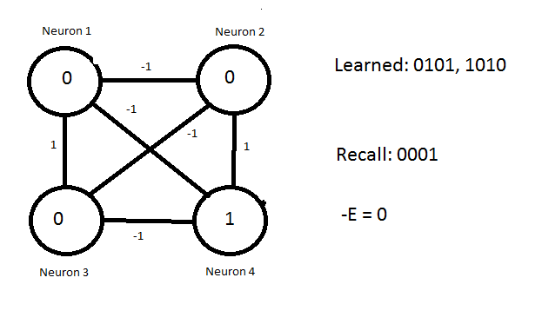
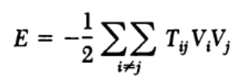


Slide 25
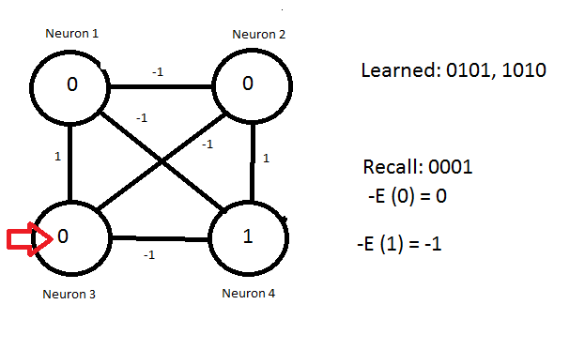

Slide 26
1
( E(1) = 1 )

Slide 27
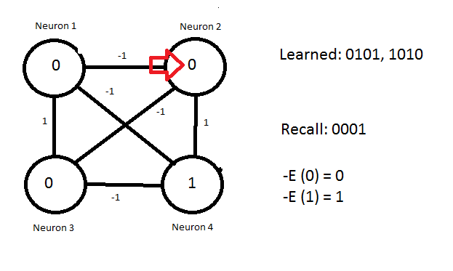

Slide 28
1
E (1) = -1

Slide 29
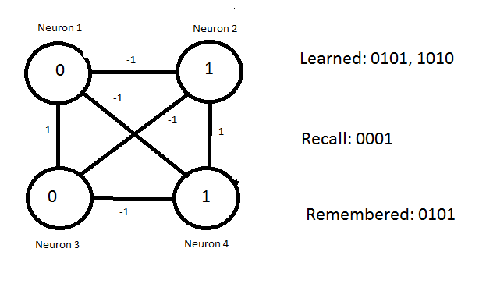

Slide 30
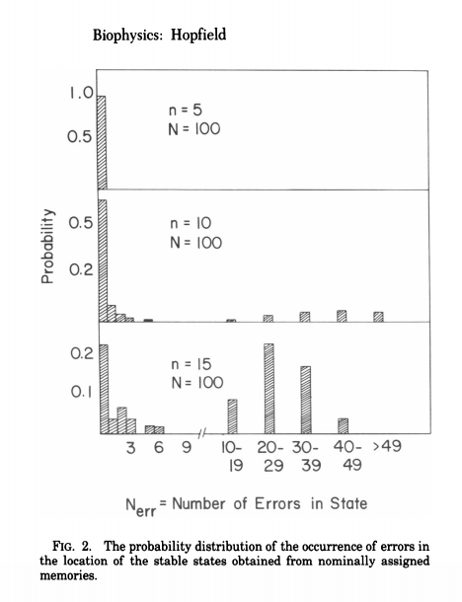

Simulations with n random memory states with corresponding T_ij generated (simulates real memories)
System started at every assigned memory state and ran until stationary
For every memory state, inverse is also trained
0.15 N states can be simultaneously remembered before error in recall is severe (N is total number of states)
Starting states usually converge to closest memory state (by hamming distance)

Slide 31
Some facts:
Using neuron weights of -1 and +1 with a threshold of 0 increases accuracy
For N = 30, n = 5 (10 stable states including inverses)
85% of trials ended in assigned memories
10% ended in states with no obvious meaning
5% ended in stable states near assigned memories (created local minima)
For hamming distance of <= 5, 90% of trials reached nearest state
Hamming distance of 12, 20% of reaching nearest state
T_ij is “clipped” to -1 or +1, the sign of T_ij for calculating the effective field of a neuron (checking if the neuron is stable and the same sign after running through the network)
Increases accuracy by a factor of 2/pi

Slide 32
Too many saved states
Too many memory states cause errors in the bits
All Memory states will most likely be unstable
Familiar and unfamiliar starting states were distinguishable by initial processing rate, which was faster for unfamiliar states

Slide 33
Memory Removal
Saturation of weight between two neurons will naturally cause forgetting
Let T_ij be 0, -1, -2, -3, 1, 2, 3
If T_ij = 3, next +1 is ignored but -1 isn’t
Noise level increases
Past memory states become unstable

Slide 34
Is T_ij = T_ji important?
Yes.
By only having one connection (T_ij != 0, T_ji = 0), it was shown that the probabilities of making errors increased. The signal-to-noise ratio decreased by a factor of 1/sqrt(2).
Local minima is still reached, just more error prone (soft failure)

Slide 35
Memory States need distance
For N = 100
50 +/- 5 Hamming units is a good distance between memories
At 30: two neurons are most likely stable
At 20: minima of the two neurons are distinct but displaced
At 10: the minima were often fused

Slide 36
State 000….. (i.e. the failure state)
Always stable
Higher energy than stored memory states
Seldom occurs
Generated when initial state does not resemble any assigned memory states
Represents starting state is not familiar

Slide 37
